Slide 1
Freshco Hypermarket Capstone PPT
Student Name : Chavi Madan

Slide 2
ORDER LEVEL ANALYSIS

Slide 3
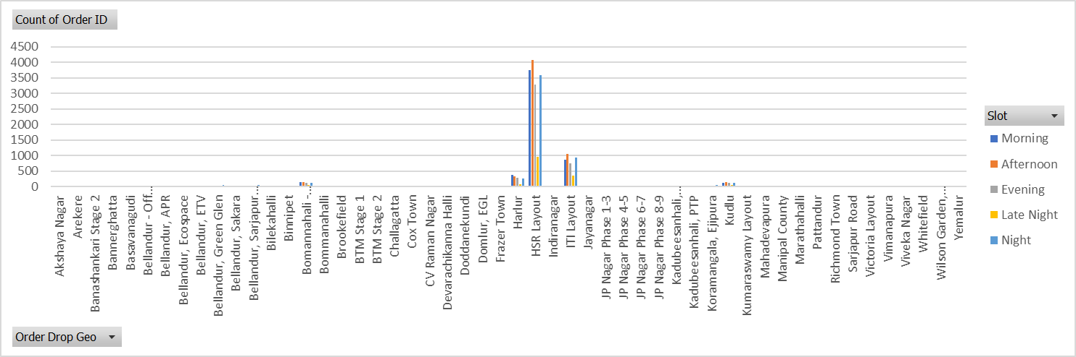
Order distribution at slot and delivery area level - In this, we have observed that:
Highest count of orders are placed in the afternoon slot & lowest are placed in late night.
Highest orders are placed at HSR Layout area followed by ITI Layout and Harlur.

Slide 4
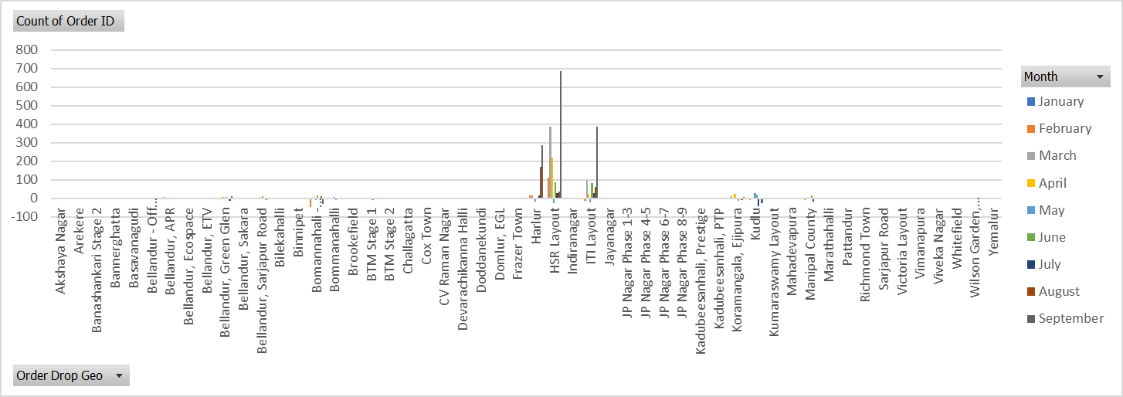
Areas having highest increase in monthly orders are:
HSR Layout, ITI Layout and Harlur areas has the highest increase in monthly orders and in the month of September.

Slide 5
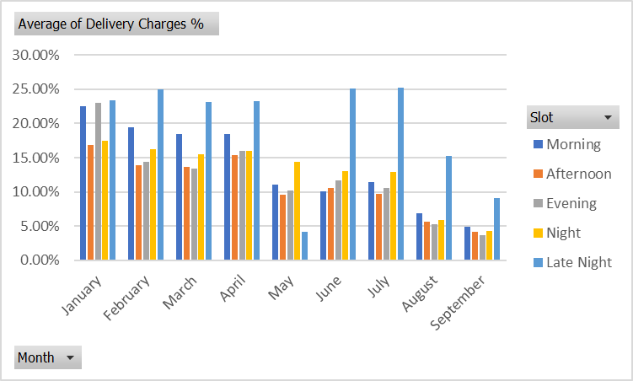
Delivery charges as a percentage of product amount at slot and month level:
As shown in the chart, the delivery charges are higher in Late Night slot.
Also, January month has highest delivery charges as a percentage of product amount.

Slide 6
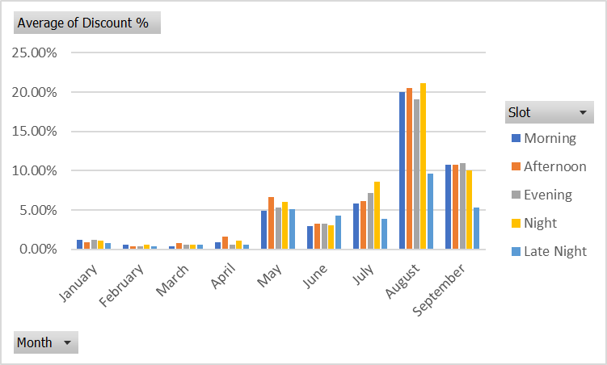
Discount as a percentage of product amount at slot and month level:
As shown in the chart, customers got more discount in month of august and it has been observed that during the night slot.

Slide 7
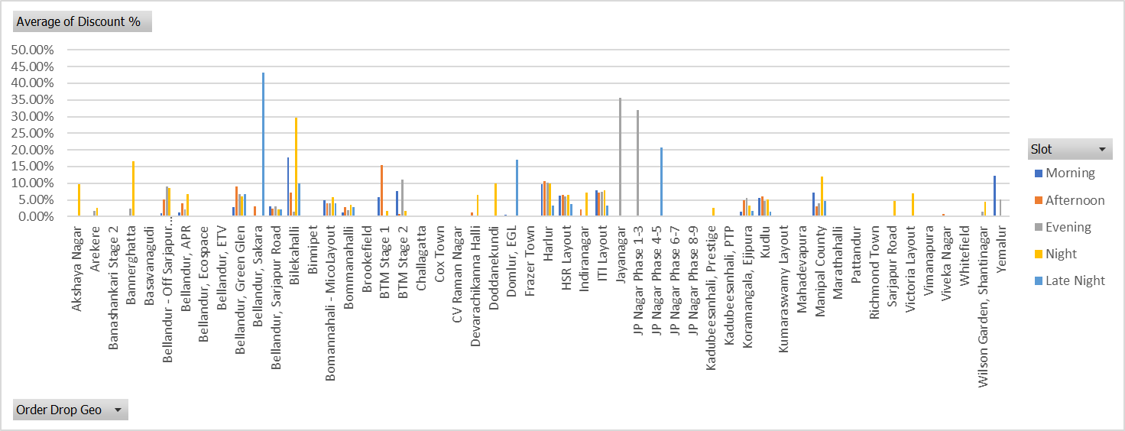
Discount as a percentage of product amount at drop area and slot level:
It has been observed that Bellandur, Sakara and Jayanagar areas have got high discounts.
The discount percentage is lowest in the Late-Night slot.

Slide 8
COMPLETION RATE ANALYSIS

Slide 9
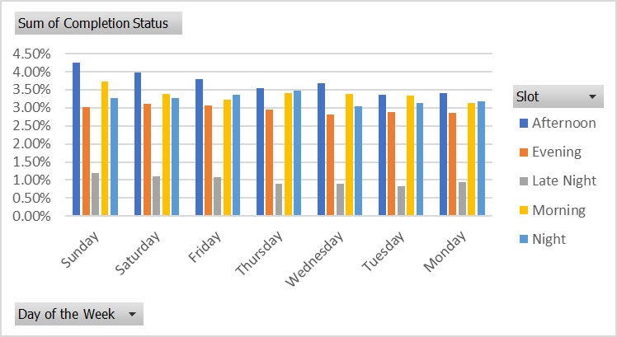
Completion rate across slots and days of the week:
Completion rate is very low in Late Night slot and comparatively high in the Afternoon slot.
Completion rate is higher on weekends (i.e. Saturday and Sunday) as compared to weekdays.

Slide 10
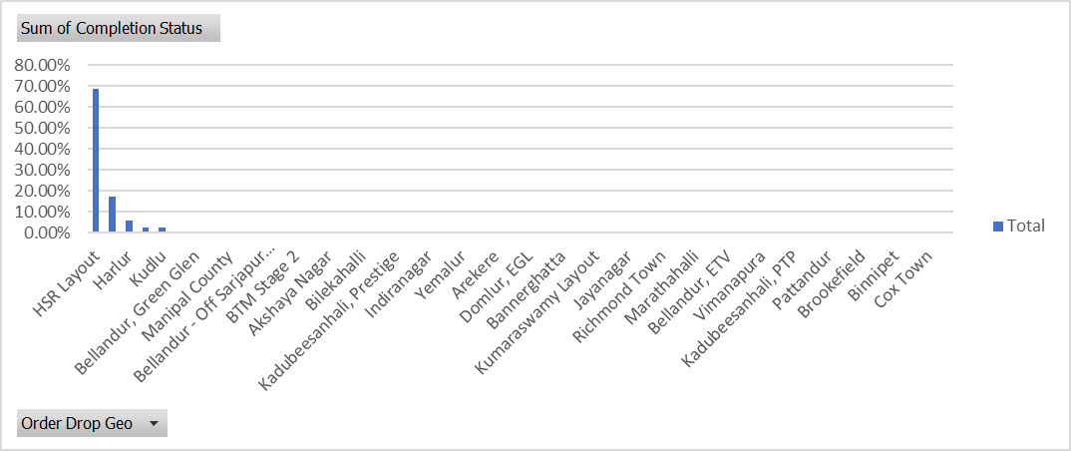
Completion rate at drop area level:
As shown in the chart, HSR layout area has the highest completion rate as 68%.

Slide 11
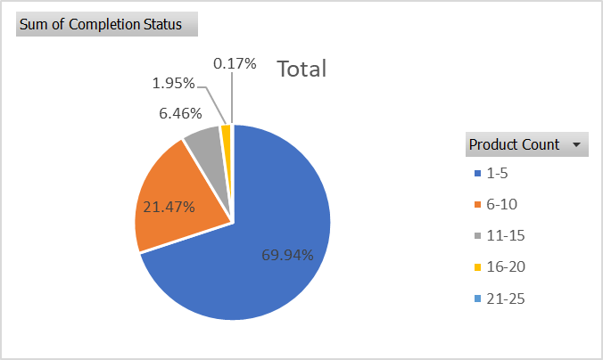
Completion rate at number of products ordered level:
Count of products ordered between 1-5 has the highest completion rate.

Slide 12
Analysis on the patterns observed in the completion rate:
The completion rate on weekends (i.e. Sat & sun) are comparatively higher than weekdays.
The HSR Layout area is having the highest completion rate.
The lesser the count of products ordered, the higher the completion rate.
Completion rate is very low in Late Night slot and high in the Afternoon slot.

Slide 13
CUSTOMER LEVEL ANALYSIS

Slide 14
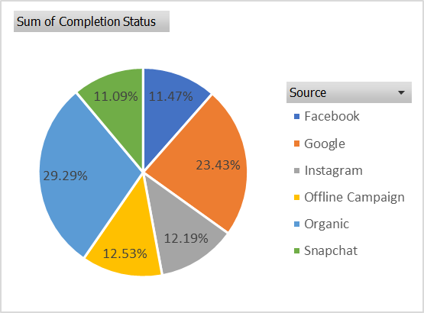
Completion rate at source level:
It is observed here that completion rate is high in Organic source as compared to other sources.

Slide 15
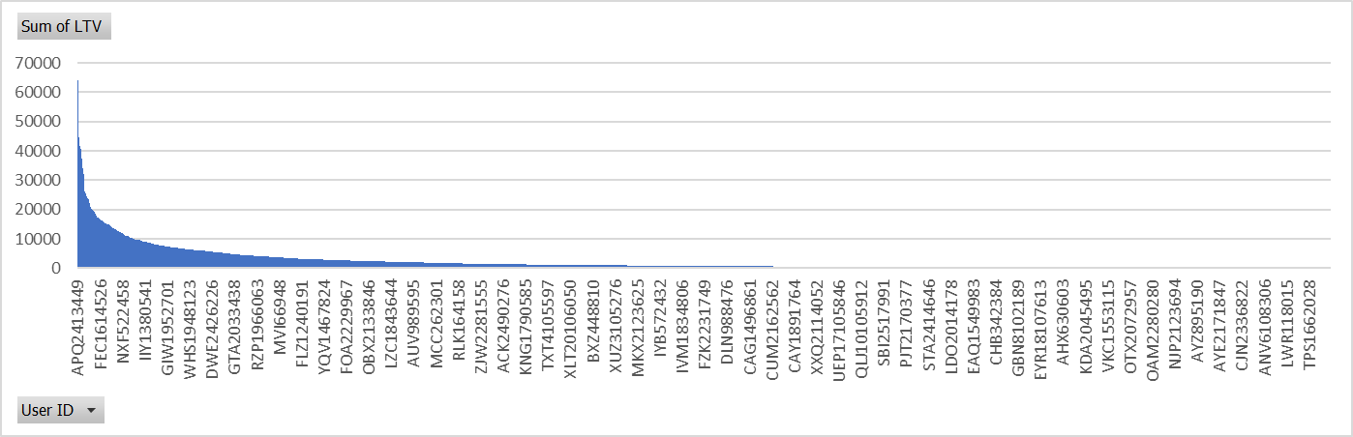
LTV (Lifetime Value) for every customer:
User ID “APQ2413449” has the highest LTV among other customers.

Slide 16
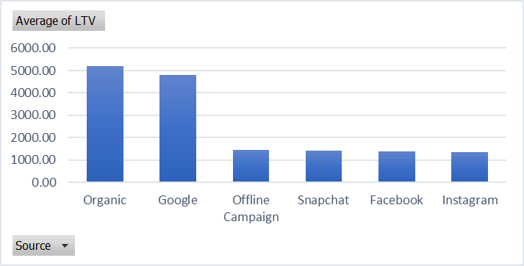
Aggregated LTV at customer acquisition source level:
As shown here, Organic has highest LTV whereas Instagram has lowest LTV.

Slide 17
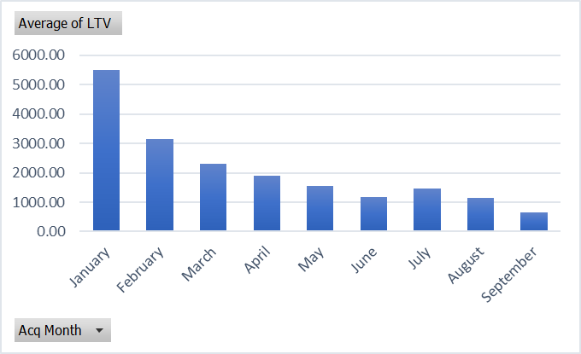
Aggregated LTV at acquisition month level:
As shown here, January month has high LTV whereas September month has low LTV.

Slide 18
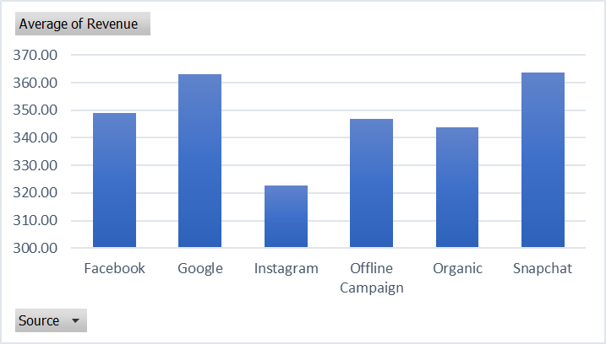
Average revenue per order at different customer acquisition source level:
As shown here, the orders received from Google and Snapchat are generating high revenue.

Slide 19
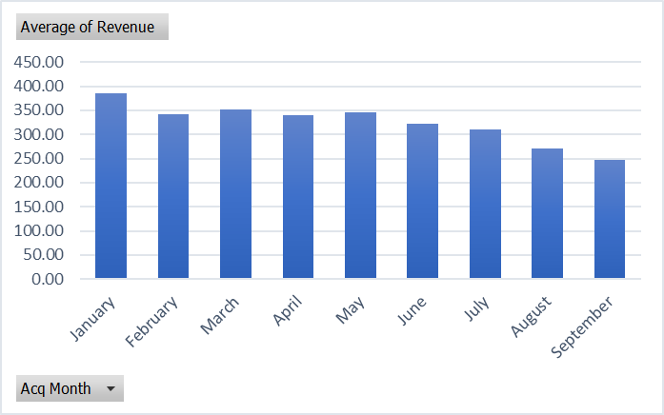
Average revenue per order at acquisition month level:
Orders received in the month of January have generated high revenue.

Slide 20
Analysis on the patterns observed in order rating across slots, number of items placed, delivery charges, discount
According to slot level, order rating is high in the Afternoon slot & low in Late Night slot.
According to number of products ordered, order rating is high when order count is between 1-5.
According to delivery charges, order rating is high when delivery charges are between 0 to 100 and low if delivery charges are above 100.
According to discounts, order rating is extremely low if discounts are above 100.

Slide 21
DELIVERY ANALYSIS

Slide 22
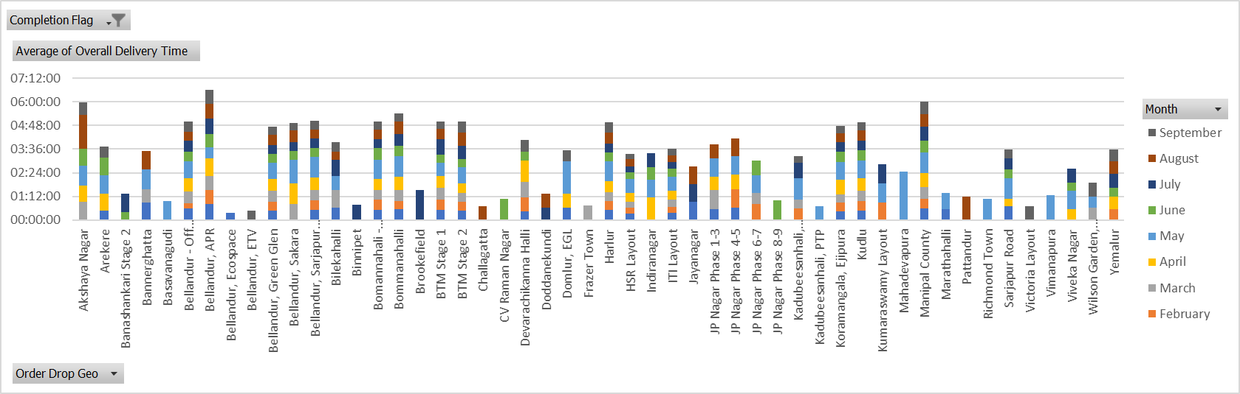
Average of overall delivery time at month and delivery area level:
As per the analysis, the delivery time is lowest in the month of June.
Also, HSR Layout area has low delivery time in almost all the months.

Slide 23
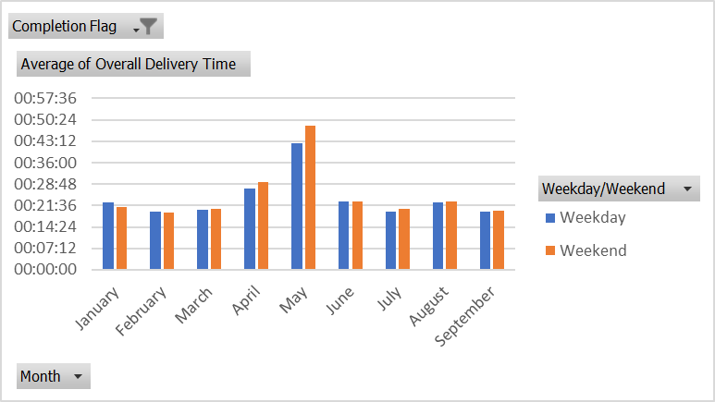
Average of overall delivery time at month and weekday/weekend level:
May month has the highest delivery time over both weekdays and weekends.

Slide 24
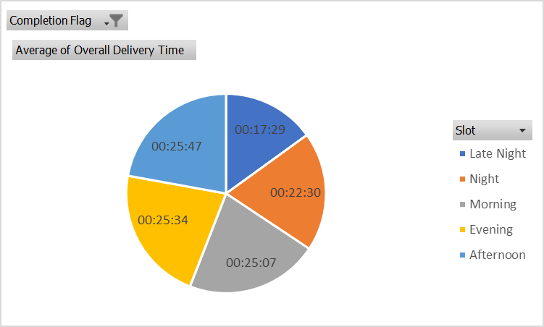
Average overall delivery time at slot level:
As shown here, the delivery time in Morning, Afternoon and Evening slots are high and almost same as 25 mins.
The delivery time at Late-Night slot is low as late night has less number of orders which are delivered in minimum time.

Slide 25
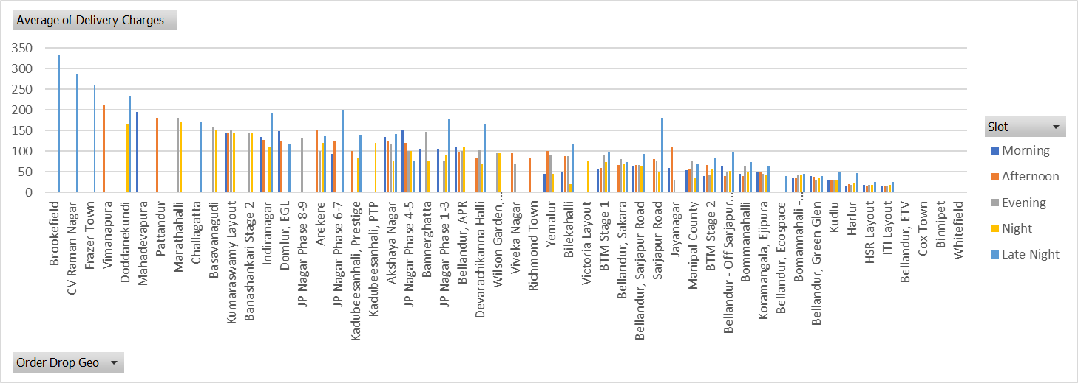
Pattern in delivery charges with slot and delivery area:
As shown here, the delivery charges are high in Late Night slot and in Brookefield, CV Raman Nagar and Frazer Town areas.

Slide 26
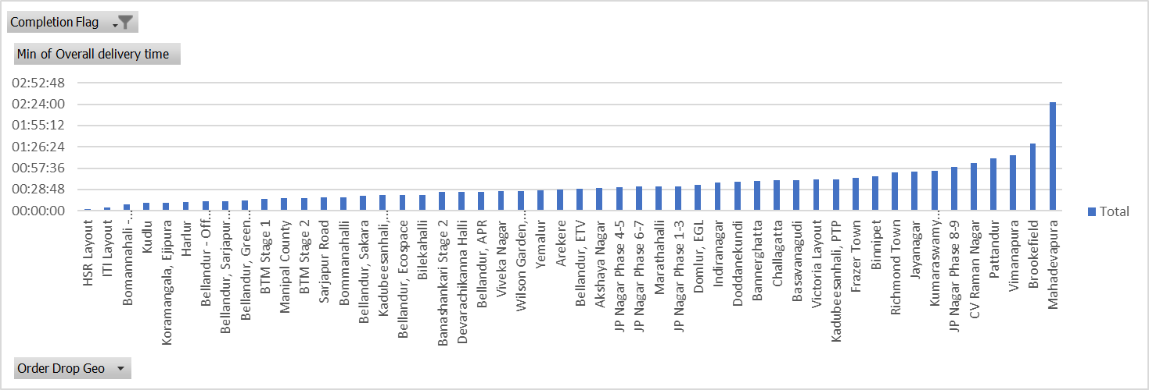
Pattern in delivery time and delivery area:
Here we can see that the delivery time is high in Mahadevapura area and low in HSR layout area.

Slide 27


